Slide 1
Job Market Analysis and Recommendation System
Next Hikes IT Solutions
Vincy Mehta

Slide 2
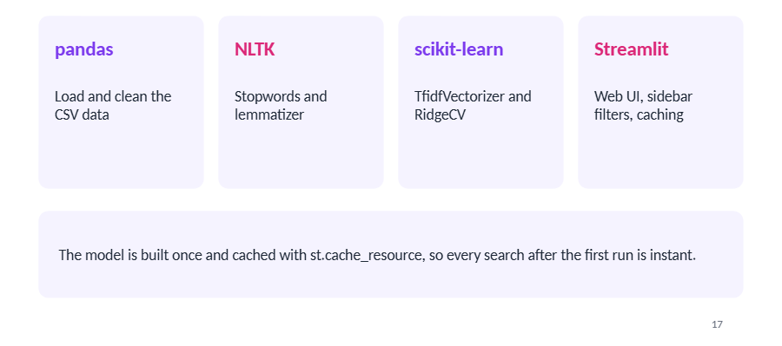
Project Toolkit

Slide 3
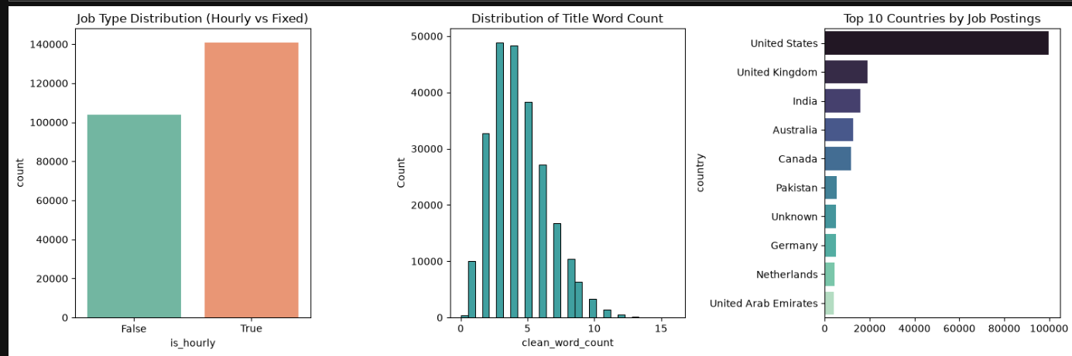
Visualizations

Slide 4
Insights
1. Job Type Distribution (Hourly vs Fixed)
Hourly jobs are more common: There are around 140,000 hourly job postings ("True") compared to approximately 104,000 fixed-price job postings ("False").
Preference for hourly rate: Clients post significantly more hourly contracts than fixed-price contracts on this platform.
2. Distribution of Title Word Count
Short titles are most popular: Most job posting titles are concise, containing between 3 to 5 words (peaking at around 48,000–49,000 postings).
Rarely exceed 10 words: Titles with more than 8–10 words are very uncommon, and almost no titles exceed 12 words.
3. Top 10 Countries by Job Postings
United States dominates: The United States leads by a massive margin, contributing nearly 100,000 job postings.
Followed by the UK, India, Australia, and Canada: The United Kingdom and India rank second and third (around 15,000–20,000 postings each), followed closely by Australia and Canada.
Other notable contributors: Pakistan, Germany, the Netherlands, and the United Arab Emirates also make the top 10 list, though with much smaller overall volume.

Slide 5
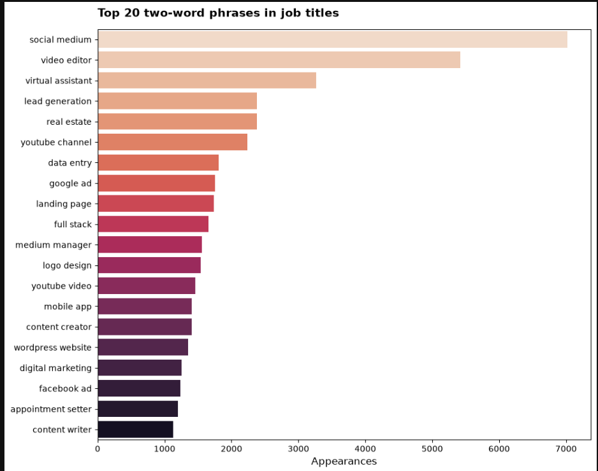
Insights
"Social medium" (media) is the clear leader: It is by far the most requested two-word phrase in job titles, appearing over 7,000 times.
High demand for video creation & virtual assistance: "Video editor" ranks 2nd with around 5,400 appearances.
"Virtual assistant" comes in 3rd with over 3,200 appearances.
Marketing & sales lead generation are top priorities: Phrases like "lead generation," "google ad," "landing page," "digital marketing," and "Facebook ad" all feature heavily in job listings.
Real estate & YouTube content are popular niches: "Real estate" and "YouTube channel" both appear over 2,000 times.
"YouTube video" also ranks high with around 1,400 appearances.
Technical & administrative skills remain steady: Roles such as "data entry," "full stack," "logo design," "mobile app," "WordPress website," and "content writer" show strong, consistent demand ranging between 1,000 and 1,800 appearances.

Slide 6
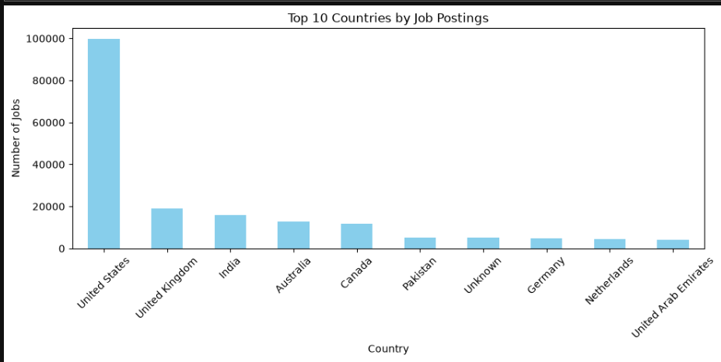
Insights
United States dominates the market: The US is by far the largest source of job postings, reaching nearly 100,000 jobs—significantly higher than all other countries combined.
Strong secondary market: The United Kingdom ranks 2nd with around 19,000 jobs. Australia (around 13,000 jobs) and Canada (around 12,000 jobs) also feature in the top 5.
India is the top Asian market: India holds the 3rd spot overall with approximately 16,000 job postings.
Lower volume among remaining top countries: Pakistan, Germany, the Netherlands, and the United Arab Emirates each contribute between 4,000 and 5,000 jobs.
A small portion of postings (around 5,000) have an "Unknown" location.

Slide 7
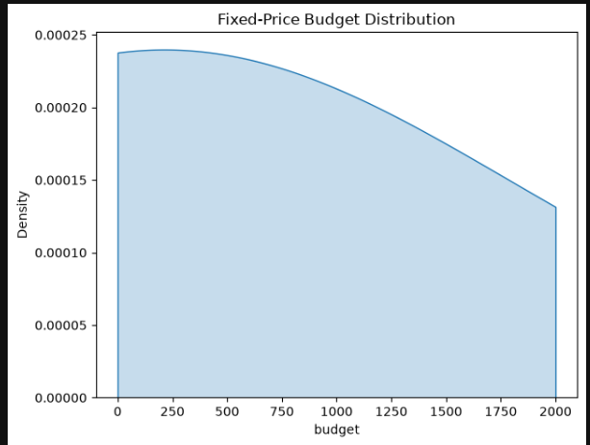
Insights
Most jobs are budgeted under $500: The highest concentration (density) of fixed-price jobs occurs at lower budget amounts, peaking between 0 and 300.
Higher budgets are less common: As the budget amount increases past 500, the density steadily drops, meaning high-budget jobs ($1,500 to 2,000) are posted far less frequently.
Budget range capped in view: The chart focuses on fixed-price projects capped at $2,000, with a broad mix of small to mid-sized projects overall.

Slide 8
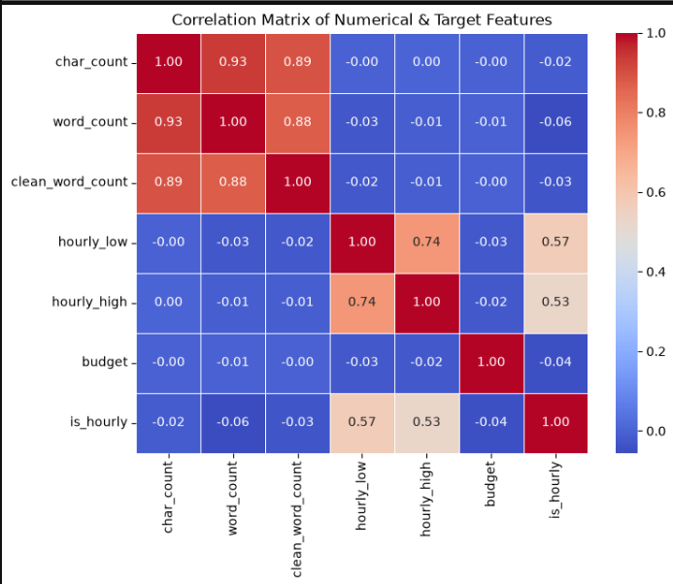
Insights
Text length features are strongly tied together: Character count (char count), word count (word_count), and clean word count (clean_word_count) have very high positive correlations (between 0.88 and 0.93). Longer titles naturally have higher character and word counts.
Hourly rates move together: The low hourly rate (hourly_low) and high hourly rate (hourly_high) show a strong positive correlation (0.74), meaning job posts with higher minimum rates also tend to offer higher maximum rates.
Hourly status links to hourly rates: Whether a job is hourly (is_hourly) shows a moderate positive correlation with both hourly_low (0.57) and hourly_high (0.53).
Text length has zero effect on job pricing: Title length (char_count or word_count) has practically no correlation (near 0.00) with hourly_low, hourly_high, or budget. The length of a title does not impact job pay.
Fixed budget is independent of other features: Fixed-price budget has virtually no correlation (near -0.01 to -0.04) with text length metrics or hourly pricing features.

Slide 9
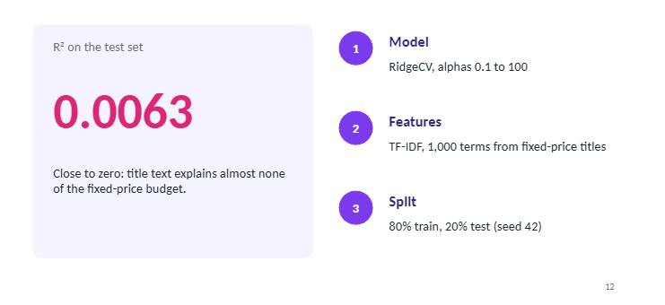
Train the model

Slide 10
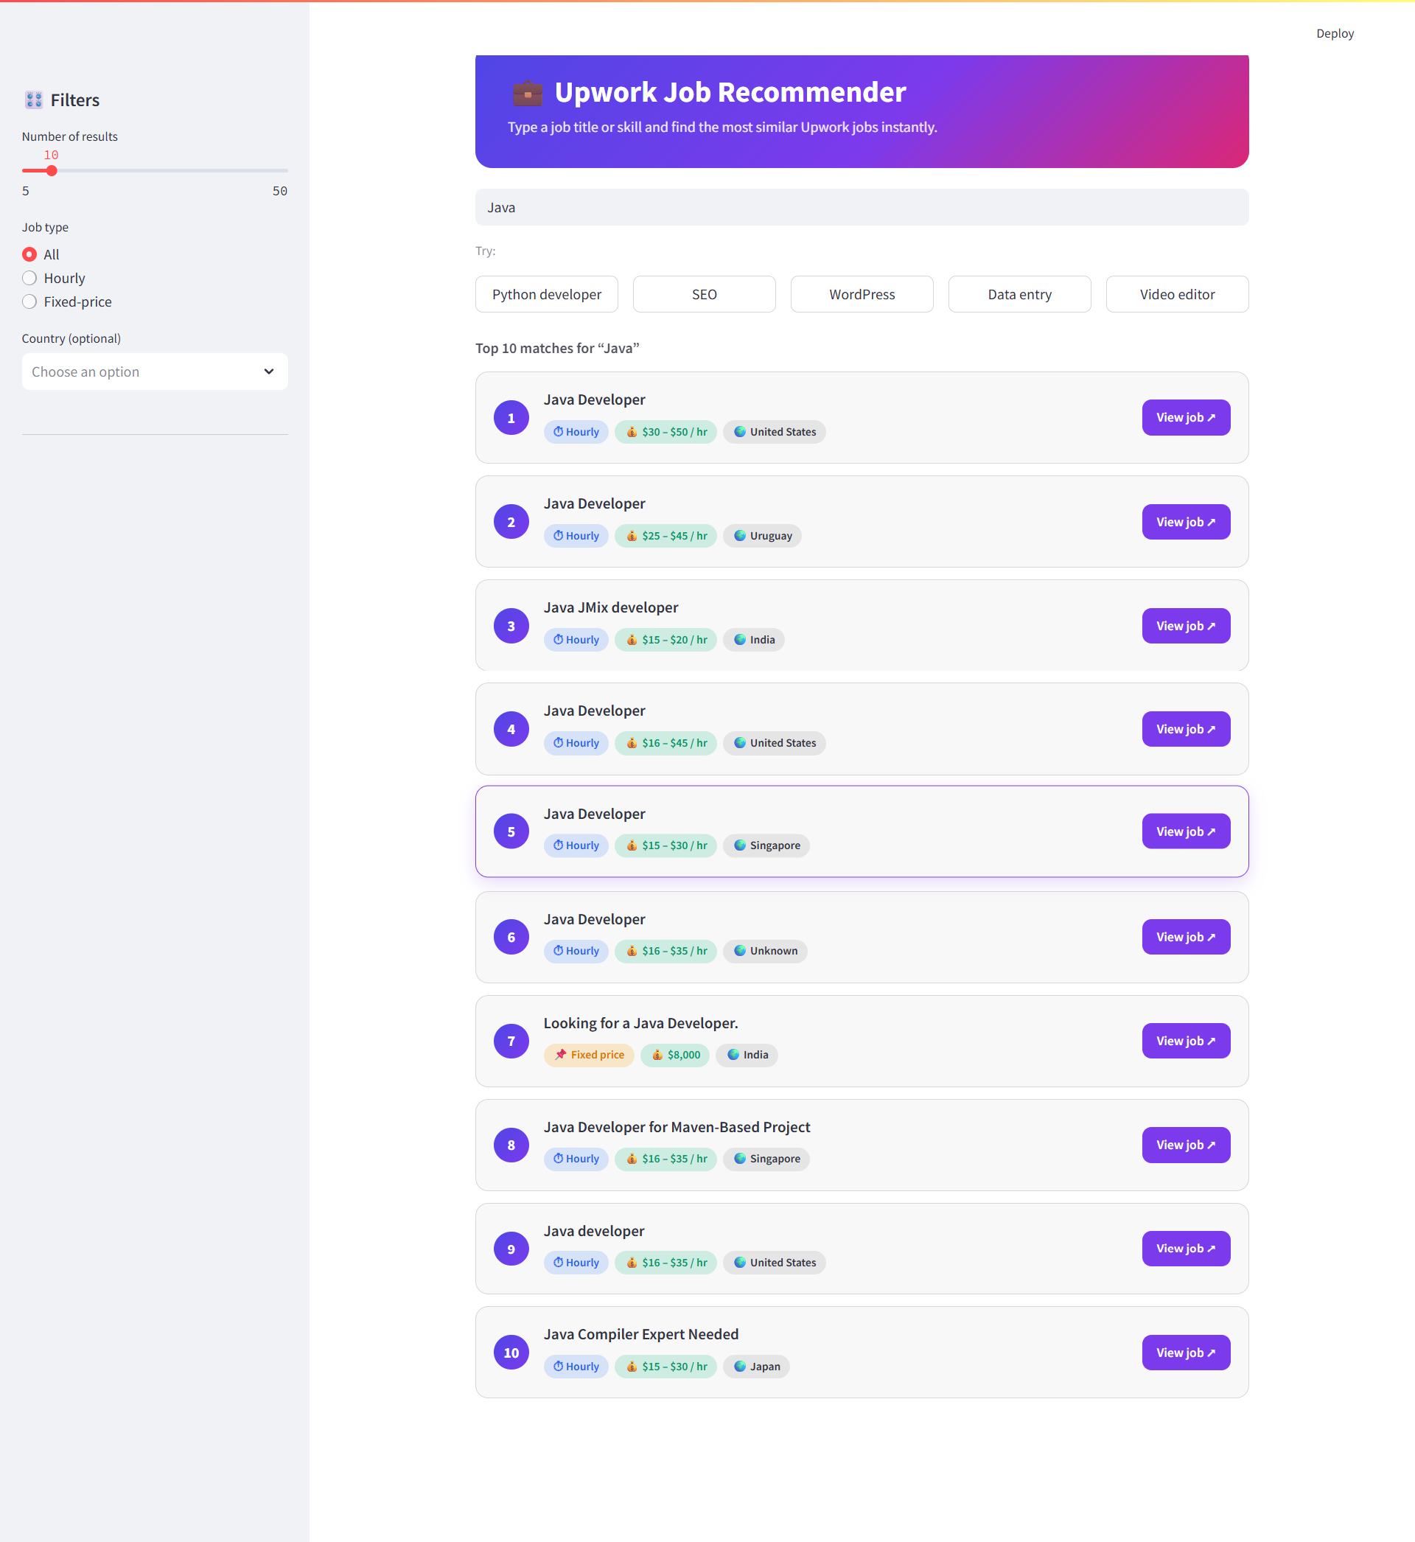
Streamlit

Slide 11
Conclusion
Most jobs on Upwork are hourly, not fixed-price.
The United States posts the most jobs, far more than any other country.
Clients want social media, video editing, virtual assistants, and marketing work the most.
Most fixed-price jobs have a small budget, under $500.
Job titles are short, usually 3 to 5 words.
The length of a title does not affect the pay.
Job titles alone cannot predict the budget.
So we used titles to build a job recommender that finds similar jobs for any skill or title.

Slide 12
Thank You

